Slide 1
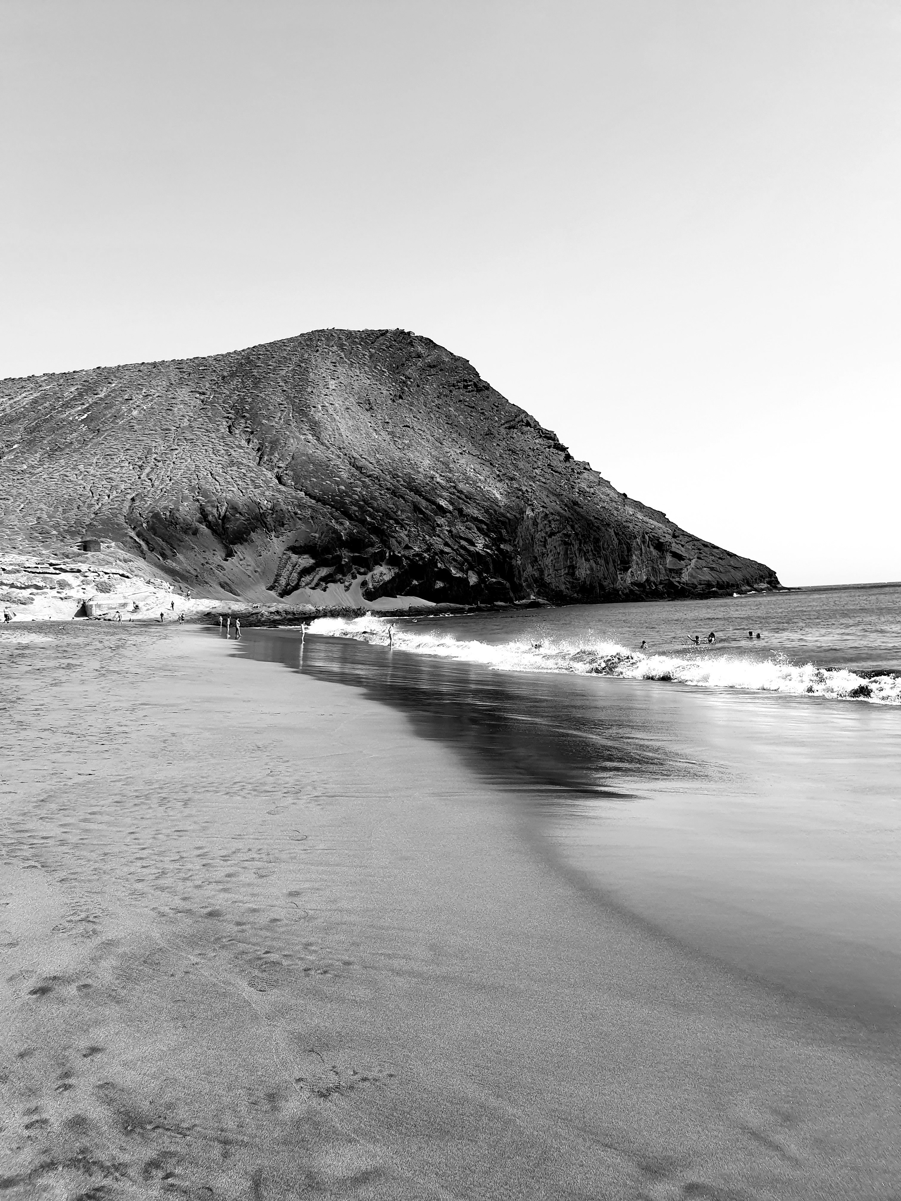
Digital Portfolio
Adeline Palmerston
Home
Photo
About Me
Contact
STUDENT NAME: M.Bharath
REGISTER NO AND NMID: 24h237 asunm1301212402334
DEPARTMENT: BCA
COLLEGE: A.M.Jain College

Slide 2
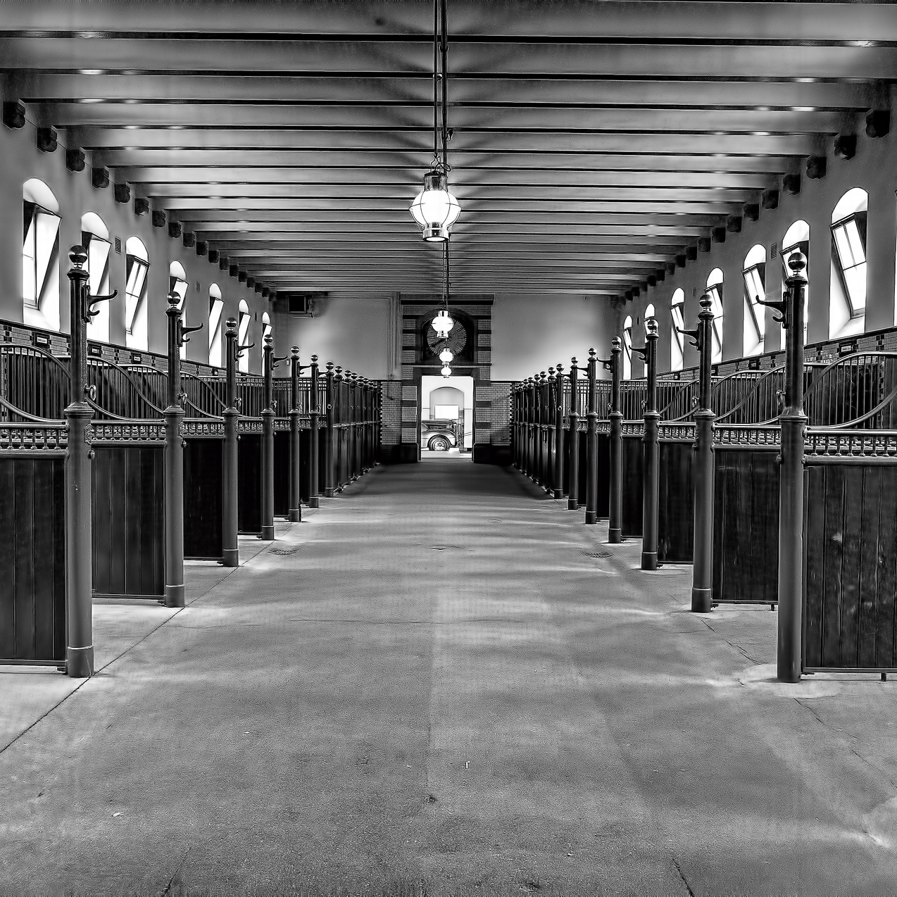
project title
Interactive Experience Portfolio

Slide 3

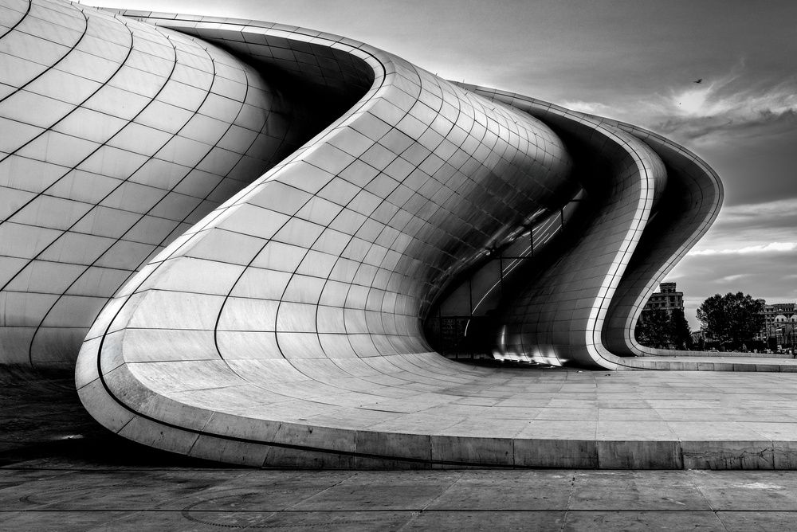
agenda
Problem Statement
Project Overview
End Users
Tools and Technologies
Portfolio design and Layout
Features and Functionality
Results and Screenshots
Conclusion
Github Link

Slide 4
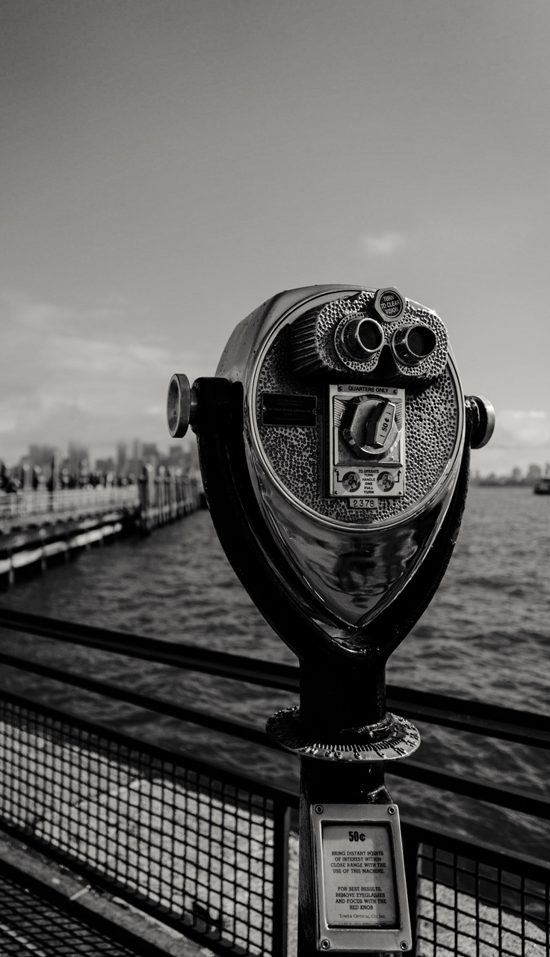
PROBLEM STATEMENT
A game developer needs a modern, engaging portfolio website to effectively showcase skills, projects, and experience with smooth navigation, theme options, and interactive features for better user experience and career opportunities.

Slide 5
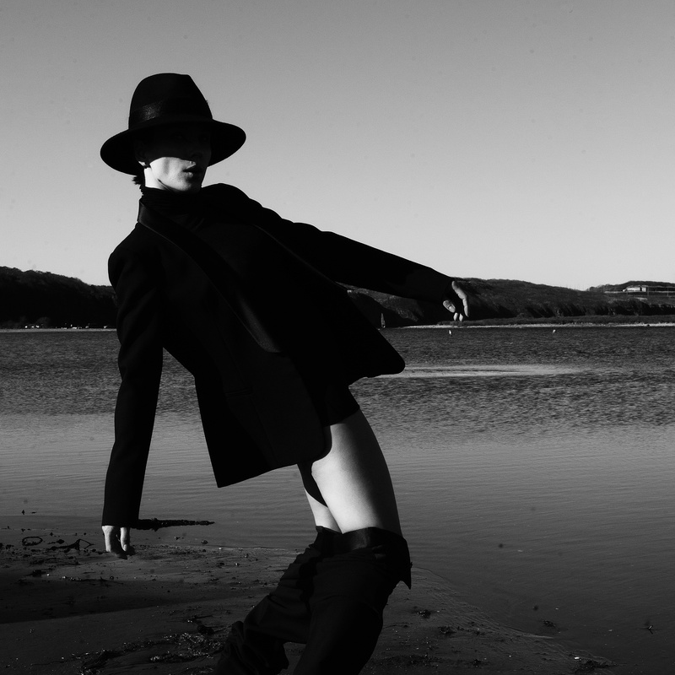

PROJECT OVERVIEW
This project involves creating a responsive, visually engaging portfolio website for M. Bharath, showcasing his game development skills, projects, and design experience. The site features smooth navigation, animated effects, a dark/light mode toggle, and a scroll-to-top button to enhance user experience. It aims to provide a professional digital presence that helps M. Bharath connect with potential employers and collaborators effectively.

Slide 6
End Users
Potential Employers: Game studios, tech companies, or design agencies looking to assess M. Bharath’s skills and projects for hiring or collaboration.
Collaborators and Freelance Clients: Other developers, designers, or clients interested in working with M. Bharath on gaming or interactive projects.
Peers and Community Members: Fellow game developers, designers, and enthusiasts who want to explore his work and connect professionally.
Recruiters and HR Professionals: Individuals seeking qualified talent in game development and interactive design.
General Visitors: Anyone interested in learning about M. Bharath’s background, skills, and game projects.

Slide 7
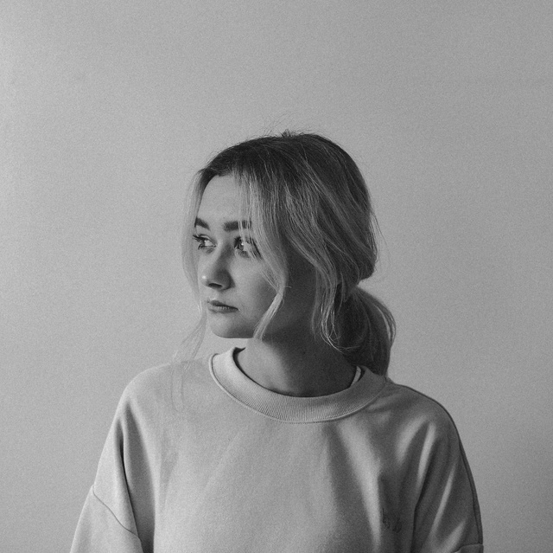

Tools and Technologies
Frontend: HTML5, CSS3, JavaScript
Icons: Font Awesome for skill and social media icons
Design: CSS Grid and Flexbox for responsive layout
Animation: CSS animations and JavaScript for interactive effects
Browser APIs: IntersectionObserver for scroll reveal effects, Canvas API for particle animation

Slide 8

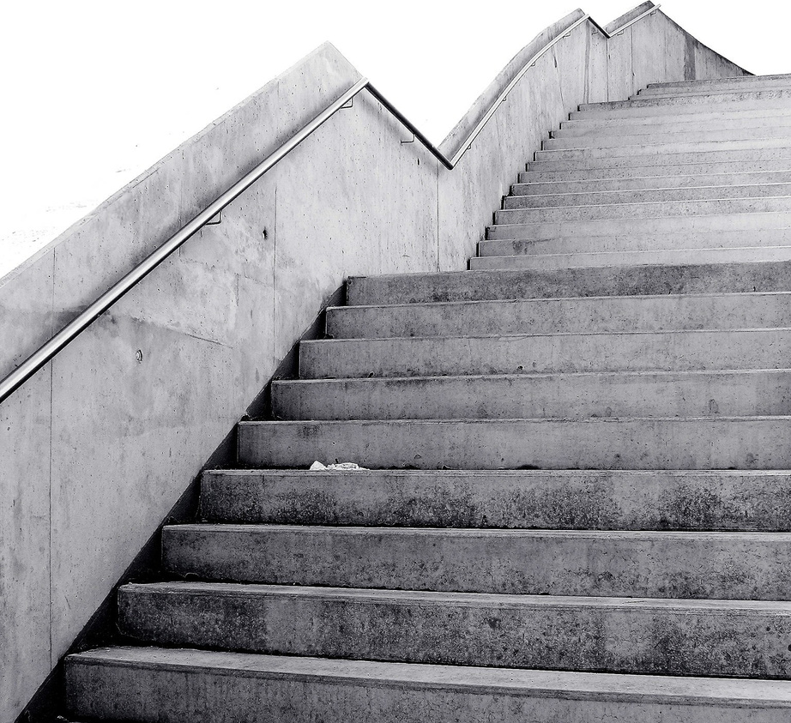
Portfolio Design and Layout
Clean, modern design with dark theme by default and optional light mode
Sticky header with navigation menu highlighting active section
Sections for Home (hero), About, Skills, Projects, and Contact
Responsive layout adapting to mobile and desktop screens
Visual hierarchy through headings, colors, and spacing for clarity

Slide 9
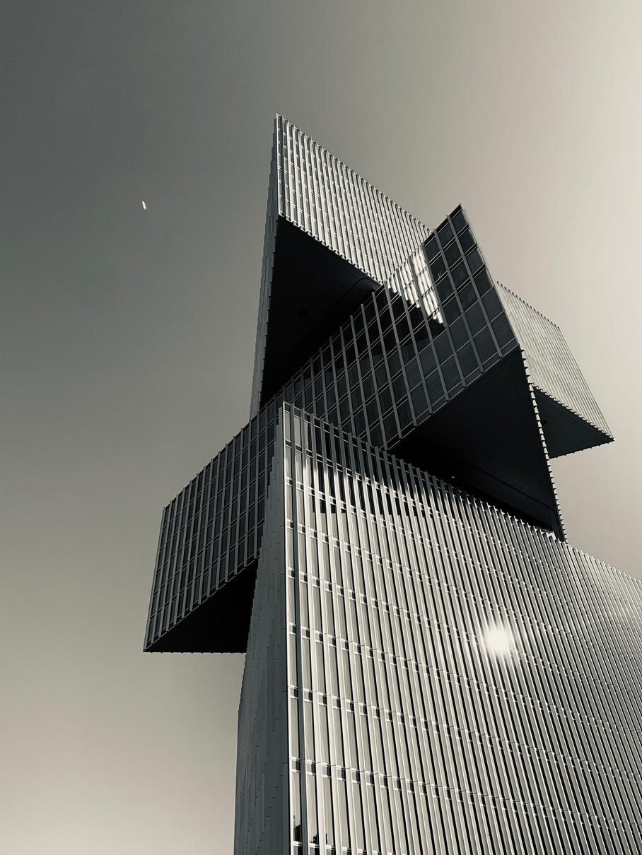
Features and Functionality
Animated gradient background and floating particle effects for engagement
Smooth scrolling and active navigation highlighting on scroll
Scroll reveal animation for sections to appear dynamically
Shiny hover effects on buttons and glowing card hover animations
Dark/Light mode toggle switch preserving user preference
Floating “Back to Top” button for easy navigation
Contact form with confirmation message on submission

Slide 10
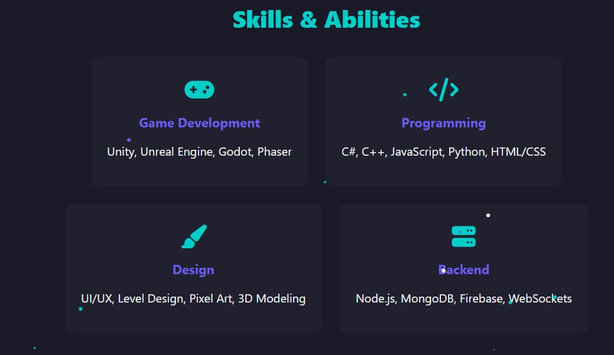
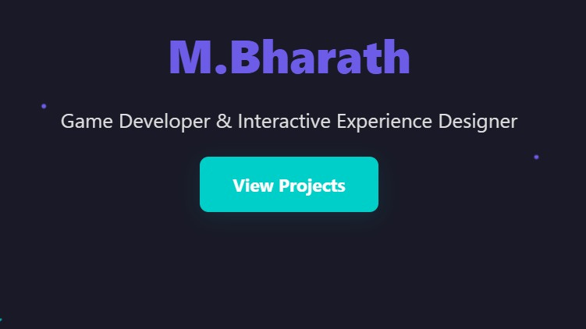
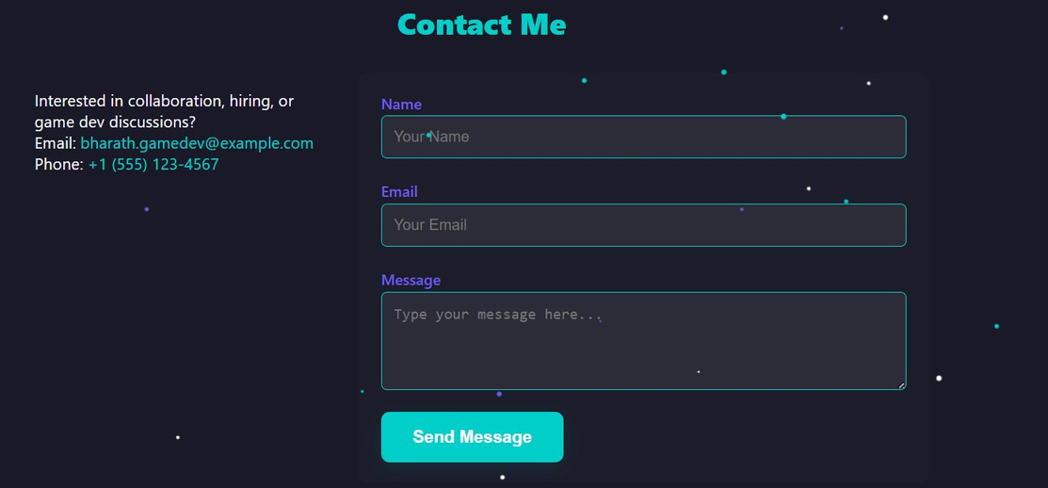
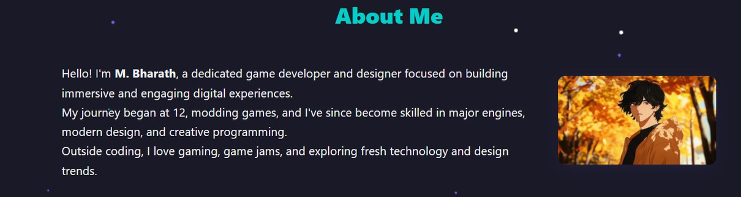
Results and Screenshots

Slide 11
Conclusion
This portfolio project successfully delivers a professional, visually appealing, and highly interactive website that effectively showcases M. Bharath’s game development and design skills. The added features like dark/light modes, animations, and user-friendly navigation improve the overall user experience, making the site a strong tool for career opportunities and networking in the game development community.

